Slide 1
EDA PREMIER LEAGUE EVOLUTION

Slide 2


Hello!
I am LT Cdr RK Gupta
I am data science enthusiast preparing for carrer transition.
You can find me at:
@ linkedin.com/in/rohit-kumar-gupta-755a2822

Slide 3
Football is like life:
It requires perseverance, self denial, hard work, sacrifice, dedication and respect for authority – Vince Lombardi

Slide 4

1.
Introduction

Slide 5
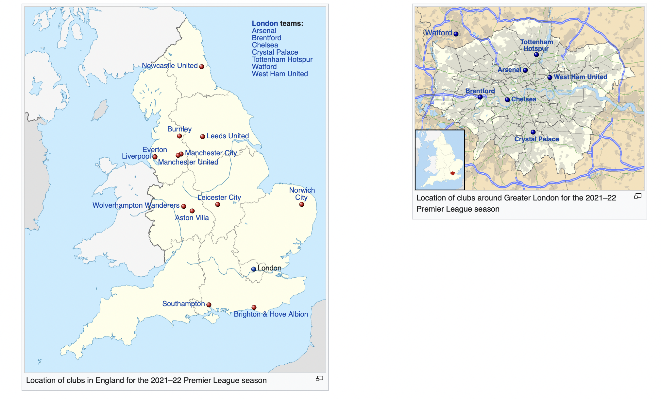
Premier League teams depiction
our office
Referred as EPL
August->May (Sat & Sun)
Most Watched league
Generates phenomenal revenue

Slide 6
212 territories
643 million homes
4.7 billion audience
That’s a lot of reach
A lot of users
Total success!

Slide 7
2.
Problem Statement
20 Teams compete
Promotion and Relegation
Qualify for International Competition

Slide 8
9 Step Work flow
Introduction
Installing / Importing Libraries
Data Pre-Profiling
3
1
3
5
7. Data- Post Profiling
2
4
6
Problem Statement
Data Acquisition
Data Pre-Processing

Slide 9
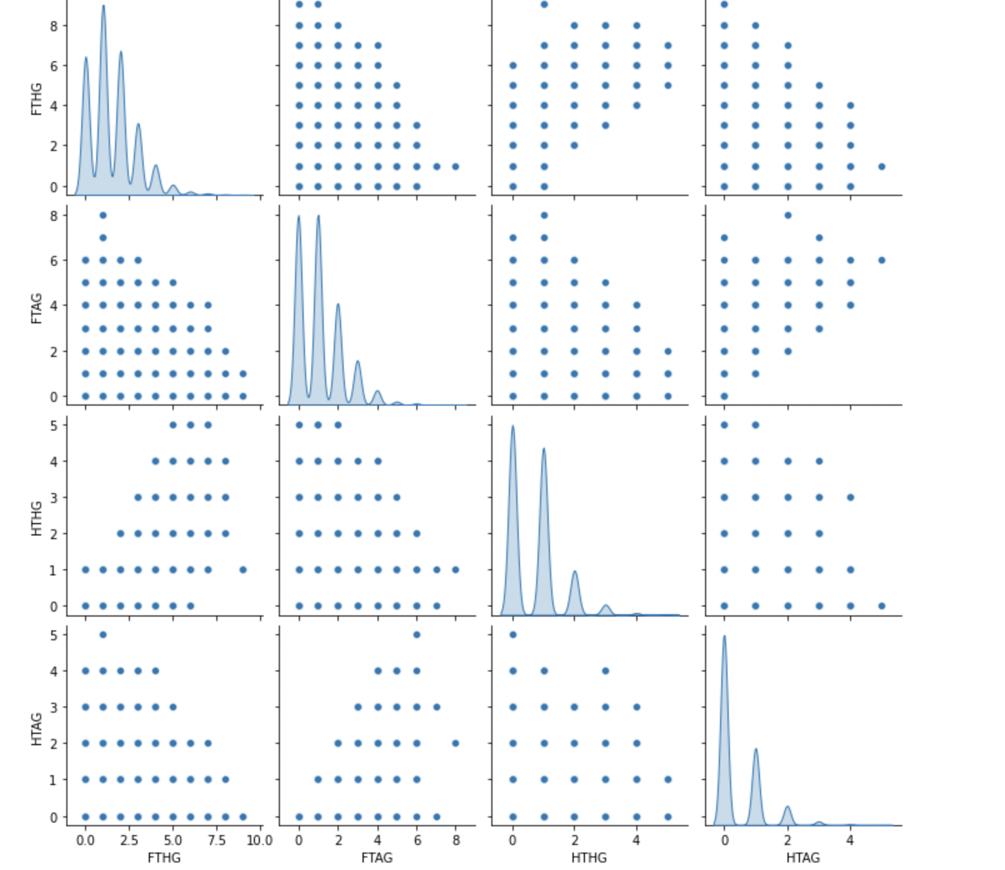
8. Exploratory Data Analysis
FTHG – Full Time Home Goals
FTAG – Full Time Away Goals
HTHG – Half Time Home Goals
HTAG – Half time Away Goals

Slide 10
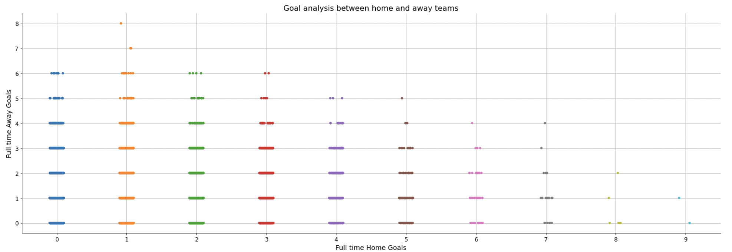
Cat Plot – Home Goals Vs Away Goals

Slide 11
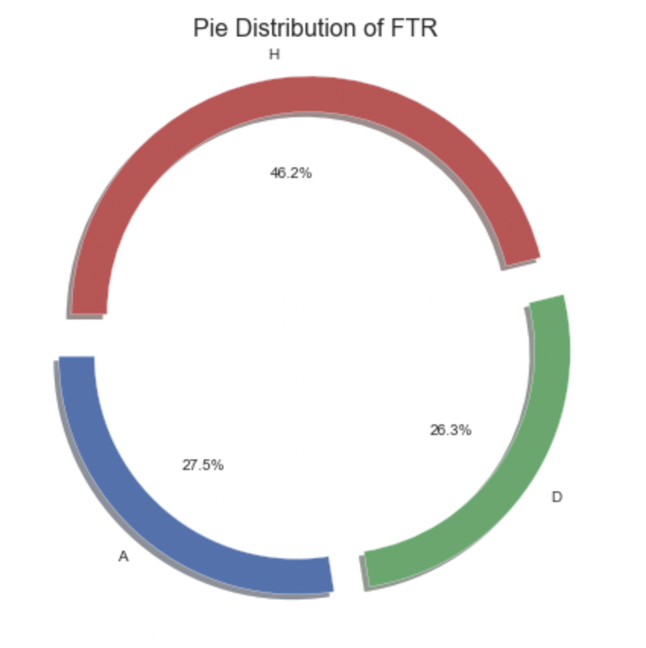
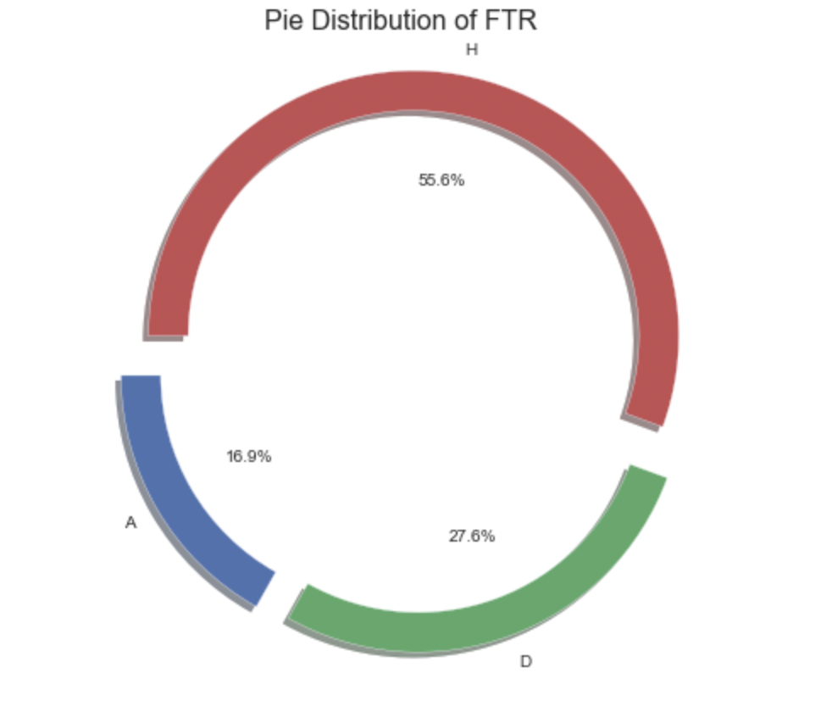
Analysis of Full time results
@Half time
Draw/ Home team lead
FTR – Full Time Result

Slide 12

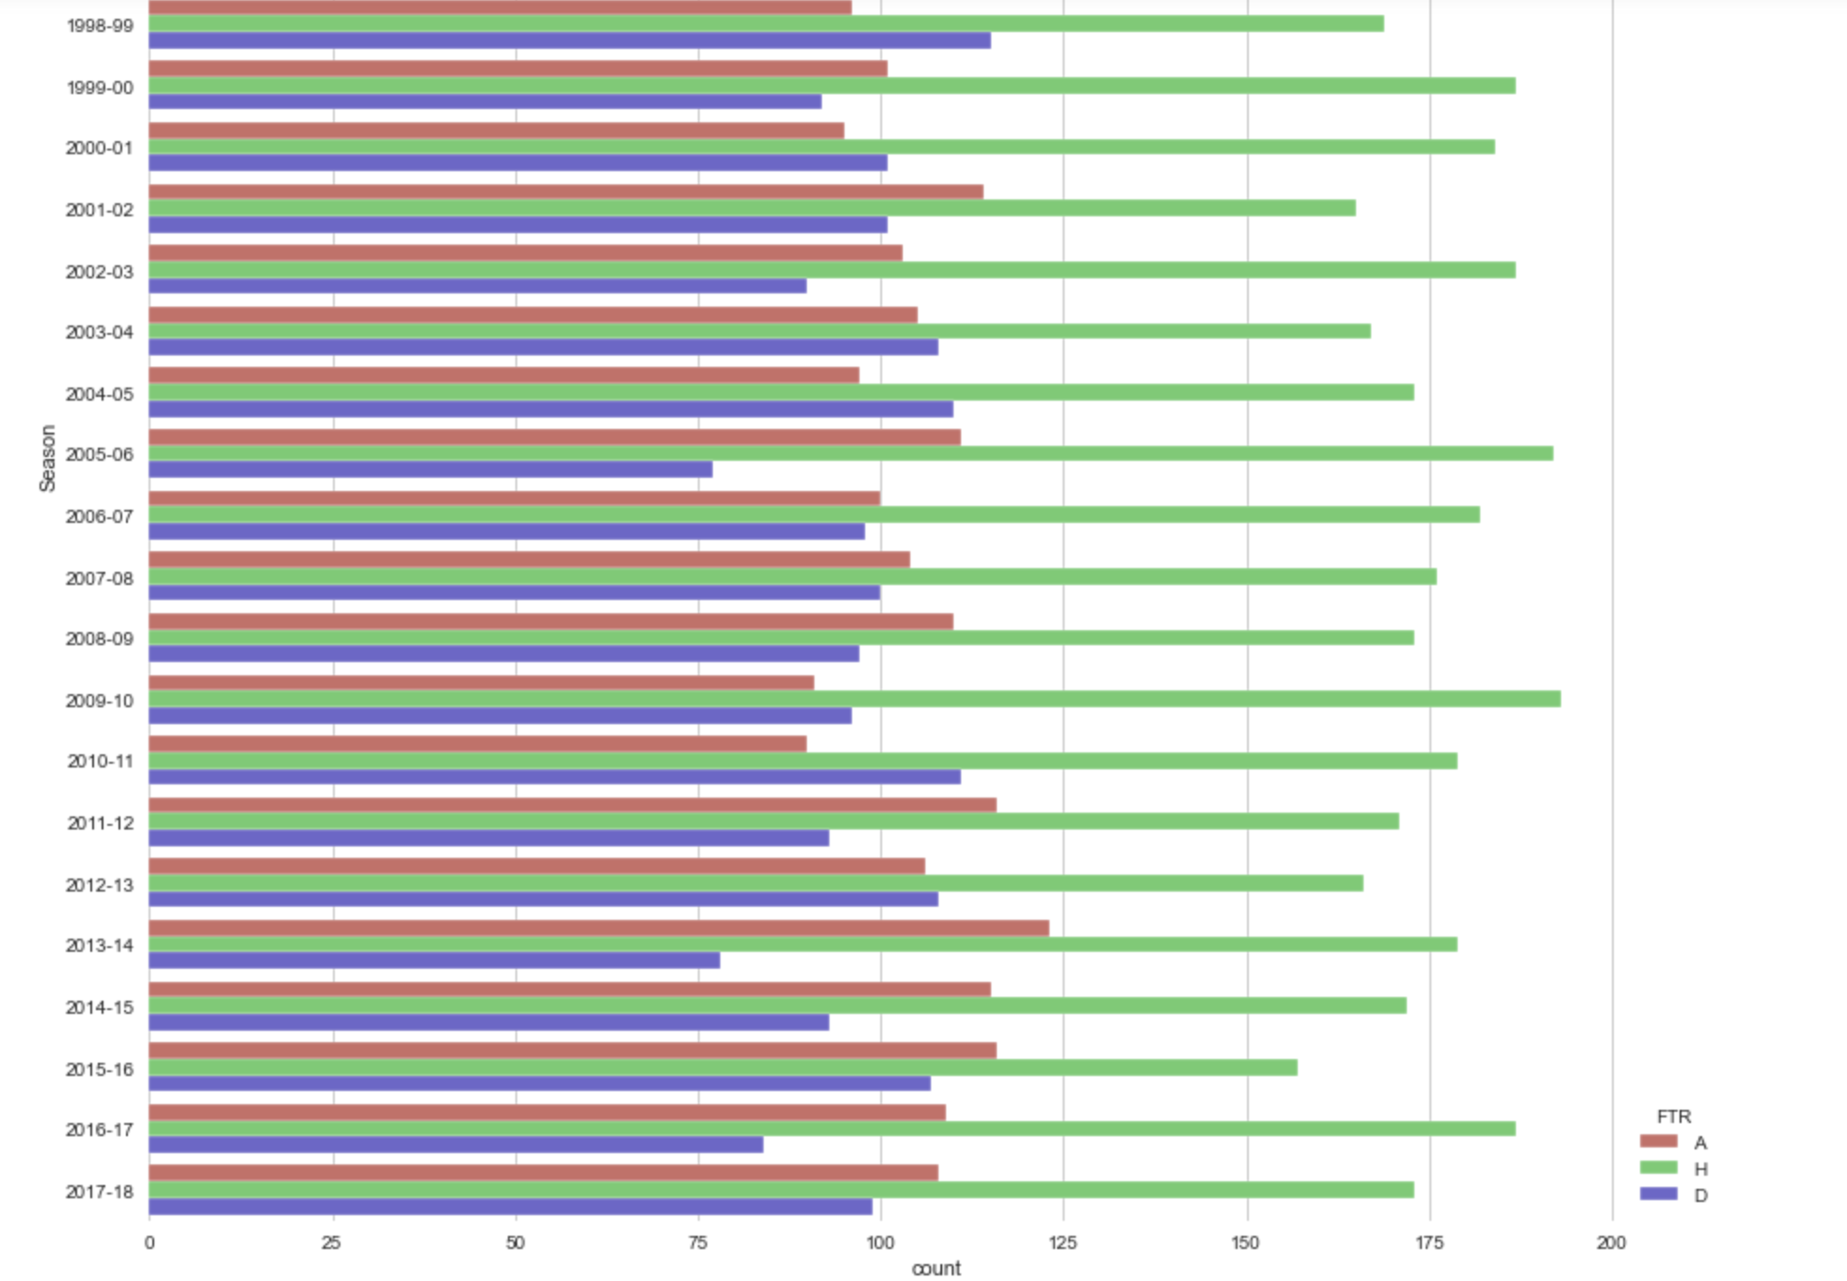
Away
Home
Draw

Slide 13
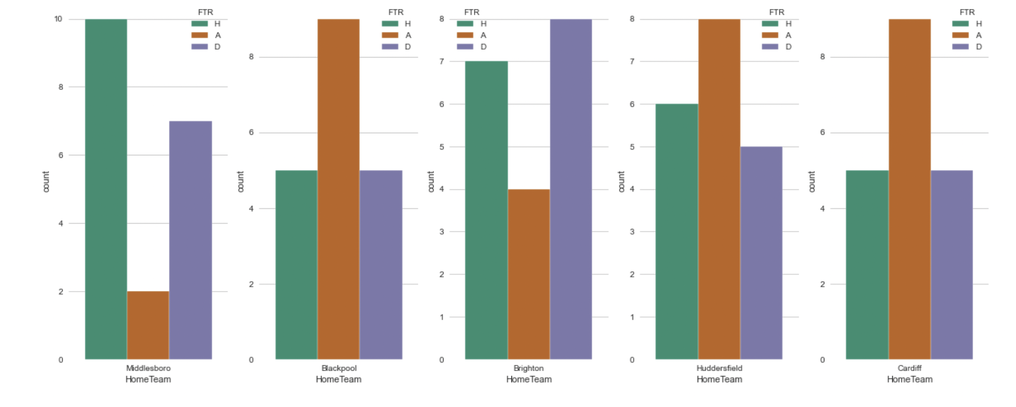
Results for teams with fewer games
White
Gray
Black

Slide 14
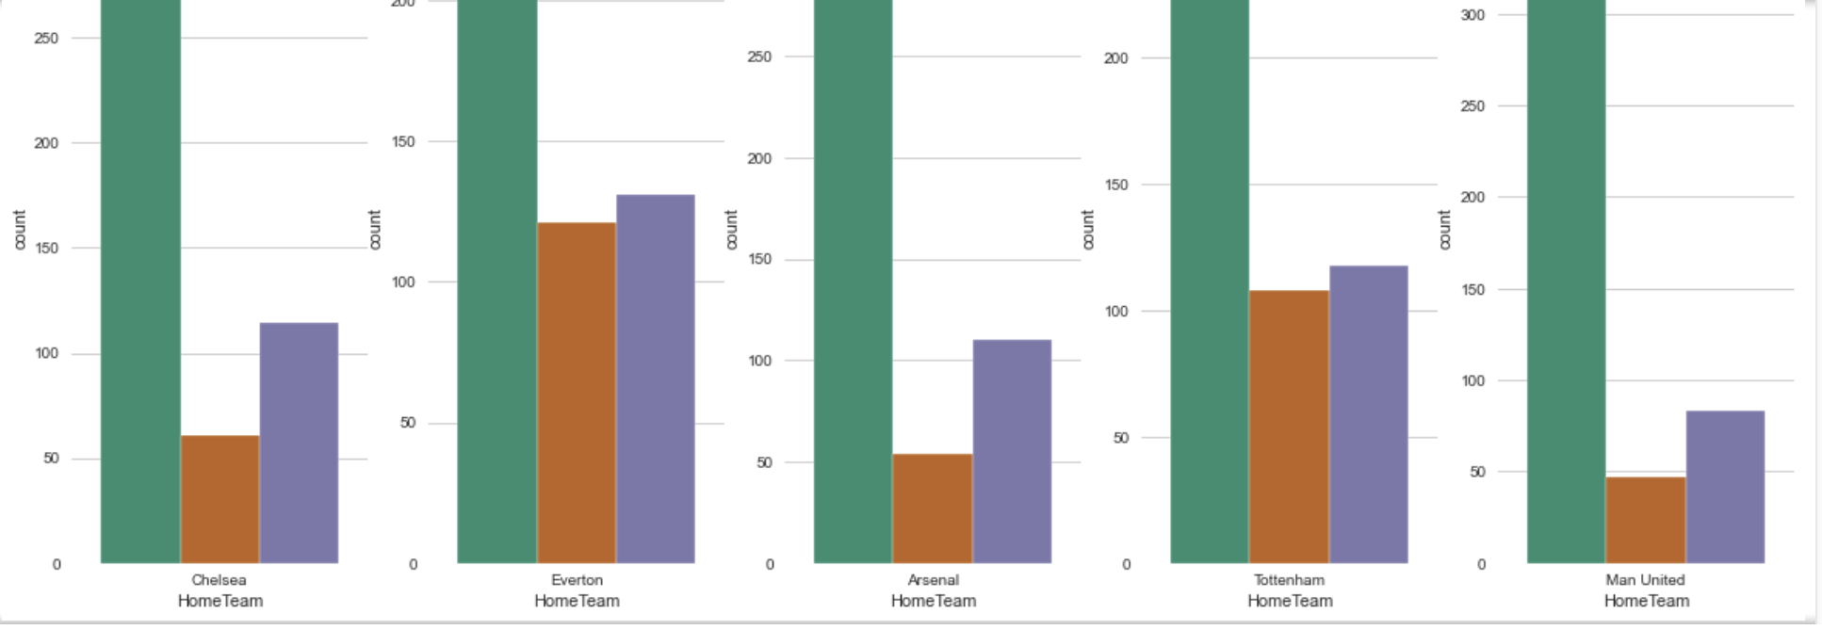
Results for teams with numerous games
White
Gray
Black
FTR – Full Time Result

Slide 15
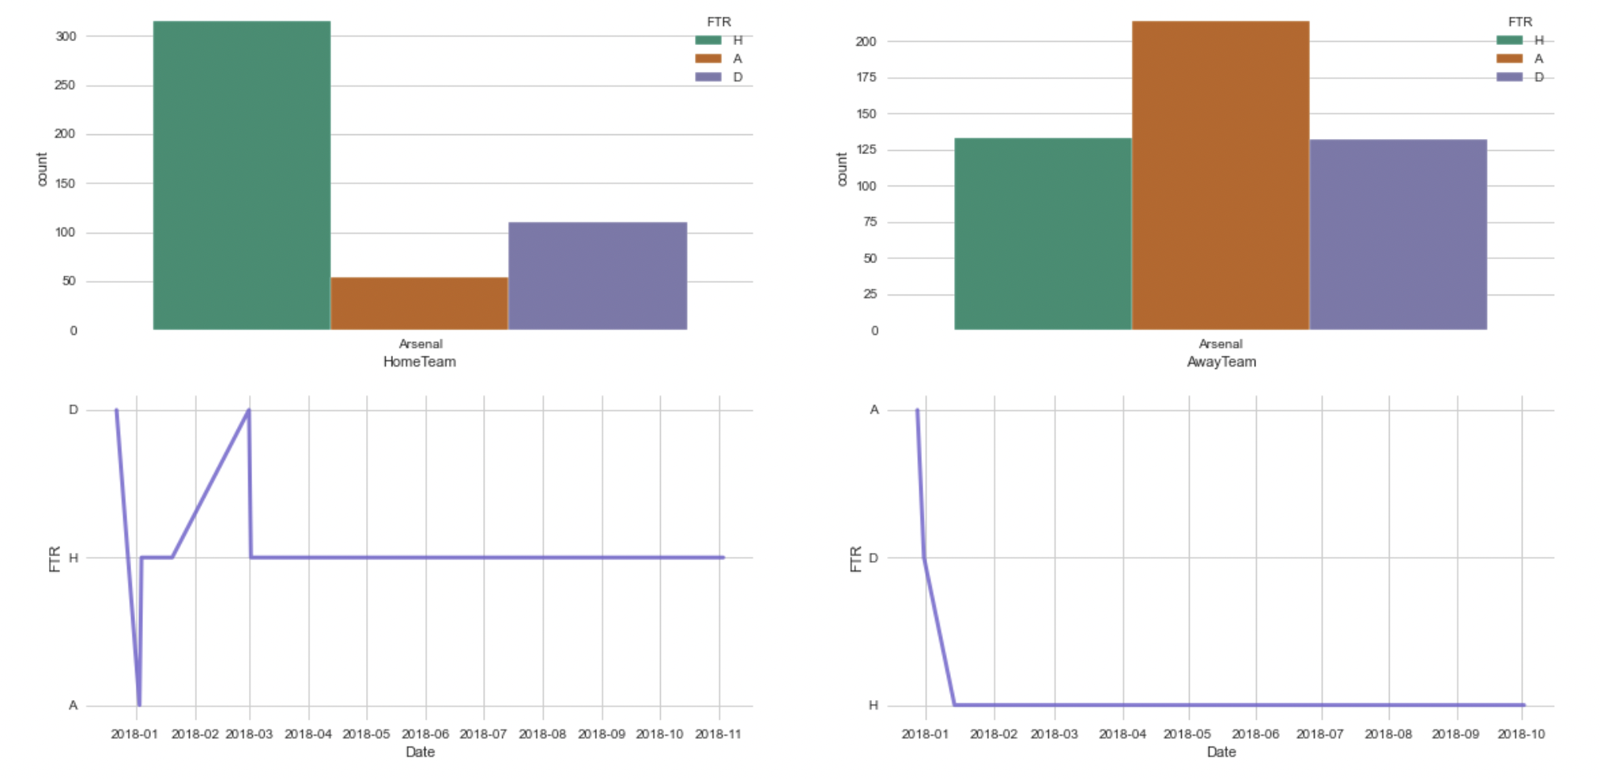
Performance of Arsenal

Slide 16
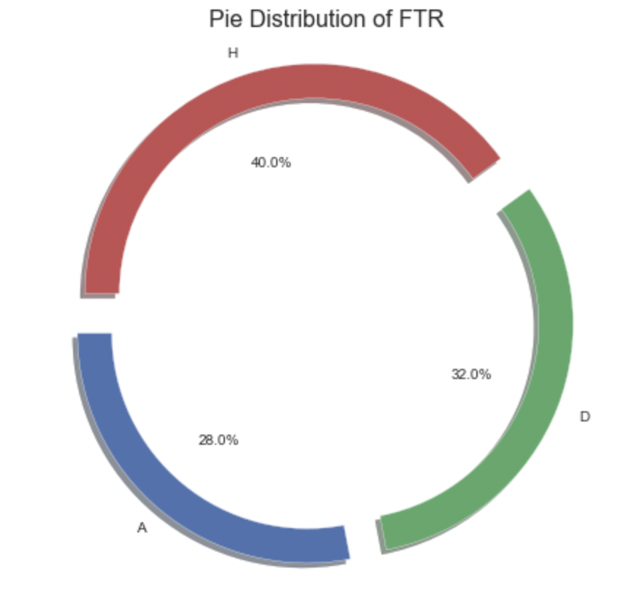
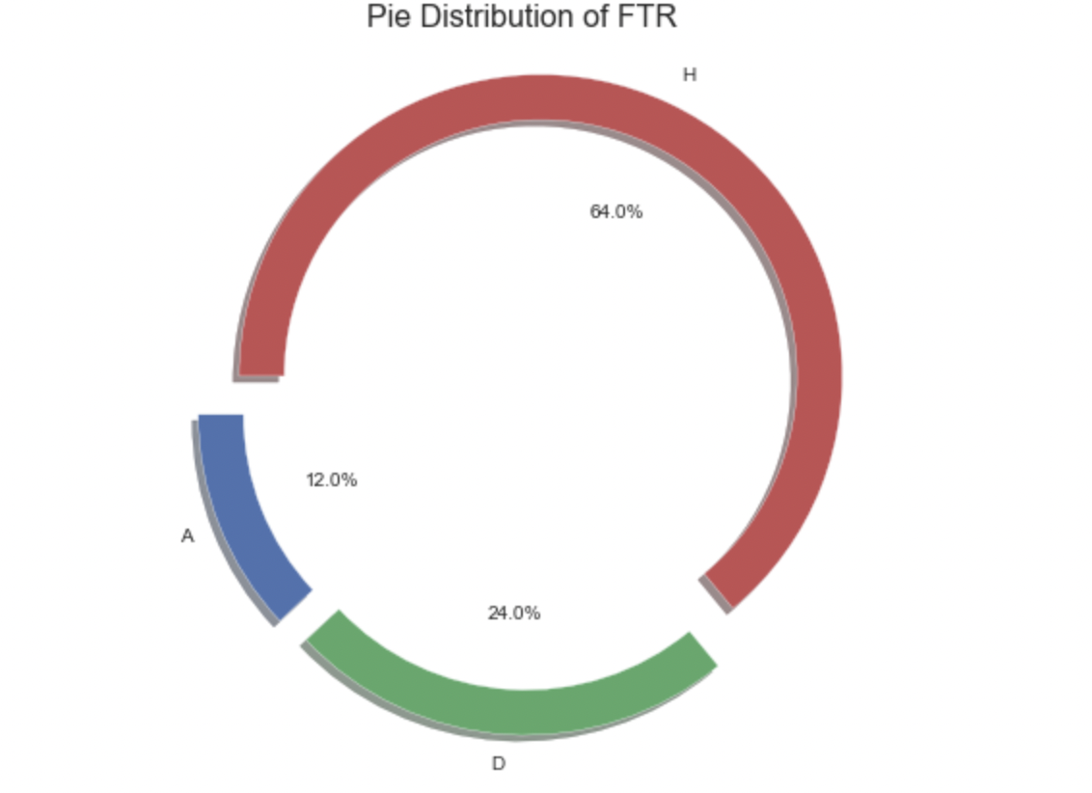
Arsenal vs Man-United
@ Arsenal
@ Man-United

Slide 17
Summarization
Clear trend exists
Advantage - Home Team
Predictions @ Half time

Slide 18
Insights
Restructuring of Games/Rules
Play/ Practise away
Take cues from successful teams

Slide 19
Thanks!
Any questions?
You can find me at:
@linkedin.com/in/rohit-kumar-gupta-755a2822
&
rohitrkg.gupta@gmail.com

Slide 20
Credits
Special thanks to all the people who made and released these awesome resources :
Training by INSAID
Presentation template by SlidesCarnival

Slide 21
2. Extra Resources
https://en.wikipedia.org/wiki/Premier_League

